Slide 1
Software Requirement Engineering Software Engineering Department Spring 2025
Muhammad Huzaifa Shah

Slide 2
Week Agenda
Software Ethics
Kinds of Software Requirements (Functional & Non-Functional)
Additional Types of Software Requirements
User & Customer Perspectives on Requirements
Common Requirement Issues

Slide 3
Week Agenda
Software Ethics
Kinds of Software Requirements (Functional & Non-Functional)
Additional Types of Software Requirements
User & Customer Perspectives on Requirements
Common Requirement Issues

Slide 4
Software Ethics
Software ethics involves the moral and professional responsibilities of software engineers to ensure their work benefits society while minimizing harm.
Key ethical concerns include:
Privacy & Data Protection (e.g., handling user data responsibly)
Security (e.g., preventing software vulnerabilities)
Fairness & Bias (e.g., avoiding discriminatory algorithms)
Accountability & Responsibility (e.g., ensuring software does not cause harm)

Slide 5
Importance of Software Ethics
Ensures Responsible Software Development
Protects Users' Rights and Privacy
Reduces Harm from Unethical Software Use
Builds Trust with Stakeholders

Slide 6
Importance of Software Ethics
Ensures Responsible Software Development
Promotes accountability in software creation, ensuring developers consider the societal and ethical implications of their work.
Example: Building systems that are inclusive and do not discriminate against specific user groups.

Slide 7
Importance of Software Ethics
2. Protects Users' Rights and Privacy
Safeguards user data from misuse or unauthorized access.
Example: Implementing encryption to secure sensitive user information like financial or medical records.

Slide 8
Importance of Software Ethics
3. Reduces Harm from Unethical Software Use
Prevents negative consequences of poorly designed or unethical software, such as unsafe autonomous vehicles or biased AI systems.

Slide 9
Importance of Software Ethics
4. Builds Trust with Stakeholders
Transparent and ethical practices strengthen relationships with users, clients, and regulatory bodies.
Example: Ethical handling of customer feedback and privacy concerns fosters loyalty and trust.

Slide 10
ACM/IEEE Code of Ethics
Public Interest & Welfare
Privacy & Data Protection
Transparency & Accountability
Professional Competence
Avoiding Harm and Conflicts of Interest

Slide 11
ACM/IEEE Code of Ethics
Public Interest & Welfare
Always prioritize societal well-being over personal or corporate gains.
Example: Ensuring software solutions improve public safety, like emergency alert systems.

Slide 12
ACM/IEEE Code of Ethics
2. Privacy & Data Protection
Commit to safeguarding user data and complying with regulations like GDPR.
Example: Do not share or sell user data without explicit consent.

Slide 13
ACM/IEEE Code of Ethics
3. Transparency & Accountability
Be honest about software capabilities, limitations, and potential risks.
Example: Clearly informing users of the limitations of AI-driven recommendations.

Slide 14
ACM/IEEE Code of Ethics
4. Professional Competence
Continuously improve skills to ensure high-quality, ethical software solutions.
Example: Regular training in secure coding practices.

Slide 15
ACM/IEEE Code of Ethics
5. Avoiding Harm and Conflicts of Interest
Minimize the risk of harm and avoid situations where personal interests conflict with professional responsibilities.
Example: Refraining from introducing vulnerabilities to benefit competing organizations.

Slide 16
Week Agenda
Software Ethics
Kinds of Software Requirements (Functional & Non-Functional)
Additional Types of Software Requirements
User & Customer Perspectives on Requirements
Common Requirement Issues

Slide 17
Types of Software Requirements
Functional requirements
Non-functional requirements
Domain requirements
Inverse requirements
Design and implementation constraints

Slide 18
Types of Software Requirements
Functional requirements
Non-functional requirements
Domain requirements
Inverse requirements
Design and implementation constraints

Slide 19
Functional Requirements - 1
Statements describing what the system does
Functionality of the system
Statements of services the system should provide:
Reaction to particular inputs
Behavior in particular situations
Abnormal behavior is also documented as functional requirements in the form of exception handling

Slide 20
Functional Requirements - 2
Functional requirements should be complete and consistent
Customers and developers usually focus all their attention on functional requirements

Slide 21
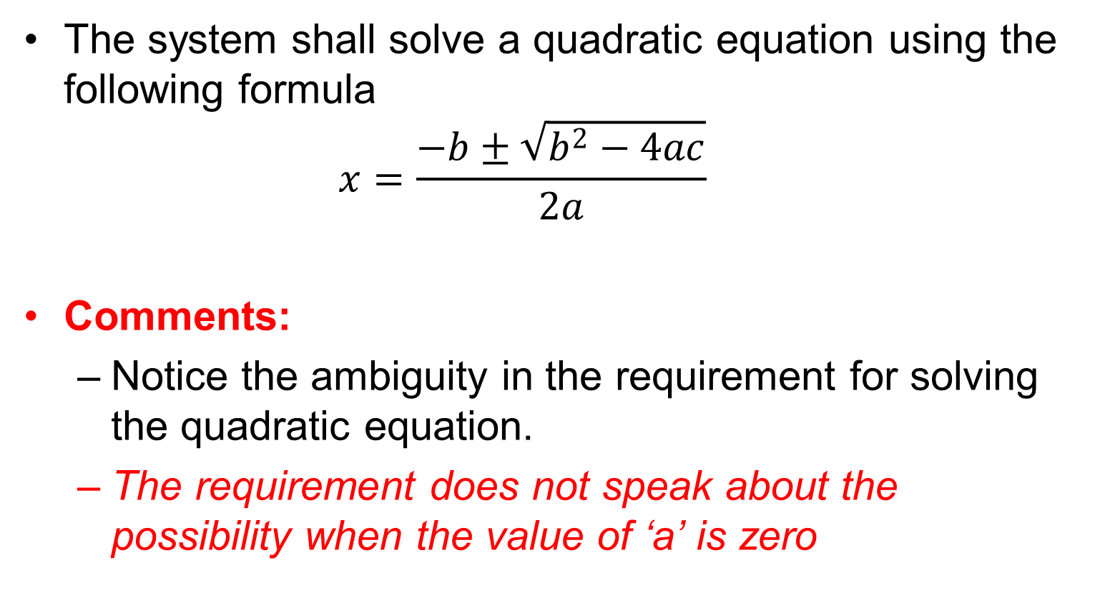
Functional Requirements Example # 1
The system shall solve a quadratic equation using the following formula
$$x=\frac{−b±\sqrt{b^{2}−4ac}}{2a}$$
Comments:
Notice the ambiguity in the requirement for solving the quadratic equation.
The requirement does not speak about the possibility when the value of ‘a’ is zero

Slide 22
Functional Requirements Example # 2
The system shall provide appropriate viewers for the user to read documents in the document store
Comments:
Notice the ambiguity in the requirement, which uses the term ‘appropriate viewers’
This requirement does not mention the formats of documents and types of viewers, which can be used

Slide 23
Functional Requirements Example # 3
Every order shall be allocated a unique identifier (ORDER_ID) which the user shall use to access that order.

Slide 24
Functional Requirements Example # 4
The system shall allow customers to return non-perishable items within fifteen days of the purchase.
A customer must present the original sale receipt to return an item.

Slide 25
Comments on Examples
Incomplete and ambiguous requirements are open to multiple interpretations and assumptions
This can lead to the development of poor quality, or faulty, software products

Slide 26
Types of Software Requirements
Functional requirements
Non-functional requirements
Domain requirements
Inverse requirements
Design and implementation constraints

